Slide 1





FIFA World Cup Analysis

Slide 2
INTRODUCTION
▶ Welcome to the FIFA World Cup Analysis project, a deep dive into the stories behind football's grandest event. We spotlight the often-overlooked analysts whose diligent efforts, aided by Python and other tools, reveal the crucial metrics and factors influencing the tournament's results. Embark on this thrilling adventure with us as we explore the intriguing narrative behind every kick, goal, and victory in the world of international football.

Slide 3
Teams with Most Goals per Cup
I plan to analyze the goal-scoring patterns of teams in each World Cup. To do this, I'll create a new dataset from the World Cup matches set through a process similar to a "map-reduce" operation:
Step 1: Extract the year, home team name, and home team goals, then sum the goals by year and team name.
Step 2: Perform the same operation as in Step 1, but for the away team.
Step 3: Combine the two datasets based on team name and year.
This approach will allow me to examine the number of goals scored by each team in every World Cup and aggregate the results across all tournaments.

Slide 4
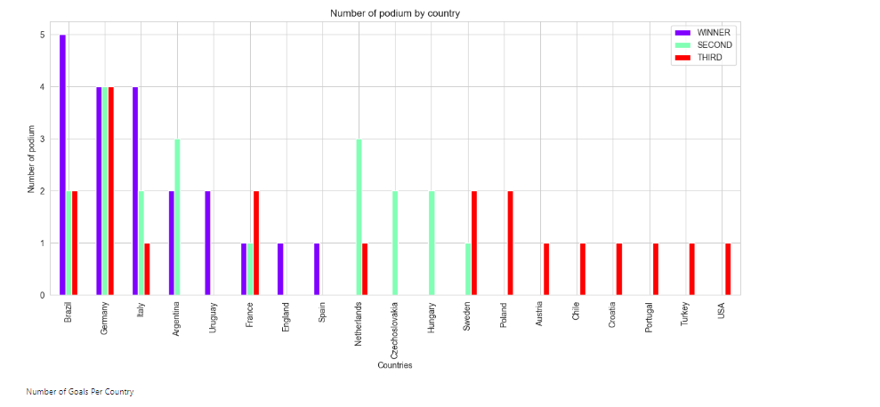
Countries That Won the Cup

Slide 5
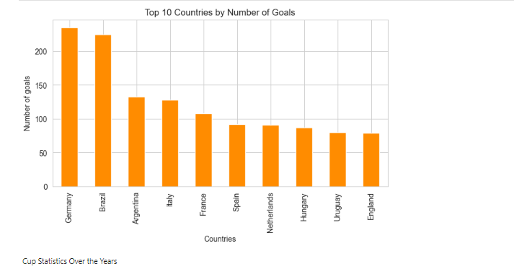
Number of Goals Per Country

Slide 6
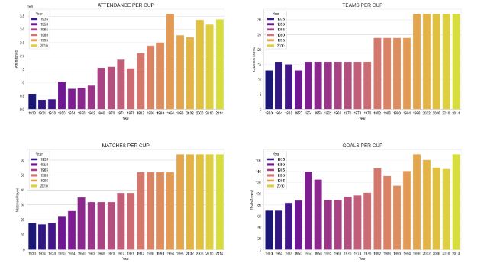
Cup Statistics Over the Years

Slide 7
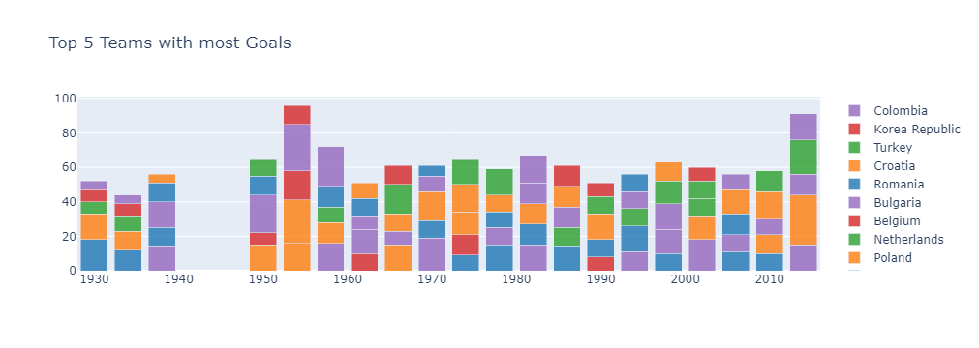
Top 5 Teams with most Goals

Slide 8
THANK YOU

